Slide 1




Java OOP Advanced
Course Introduction
Java
OOP Advanced
SoftUni Team
Technical Trainers
Software University
http://softuni.bg
Notes:
© Software University Foundation – http://softuni.org
This work is licensed under the Creative Commons Attribution-NonCommercial-ShareAlike license.
<number>

Slide 2
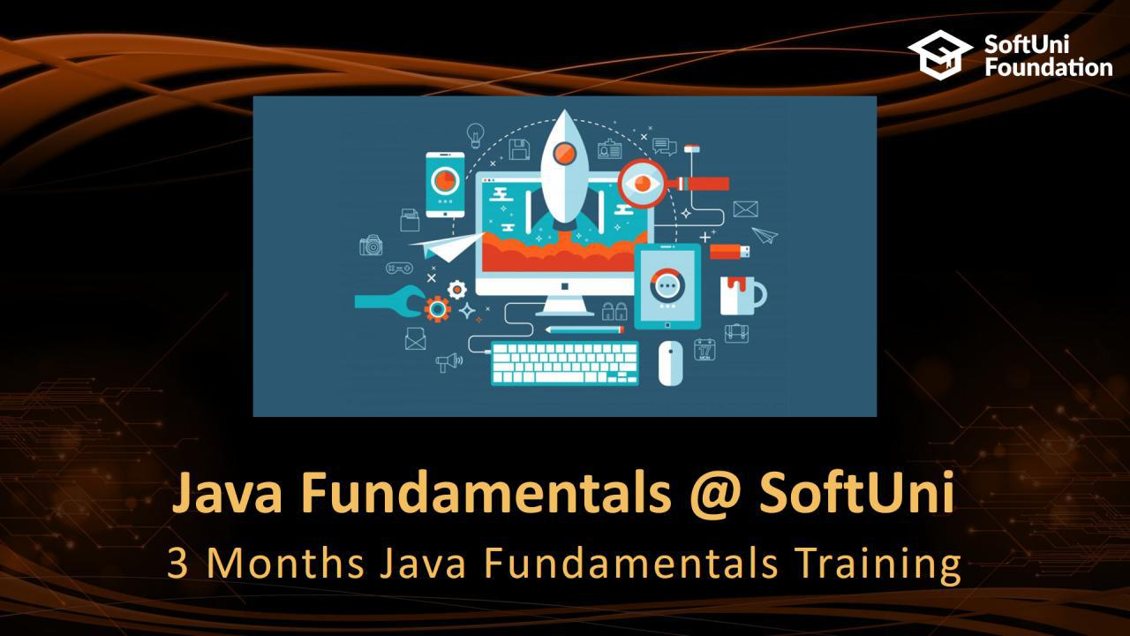

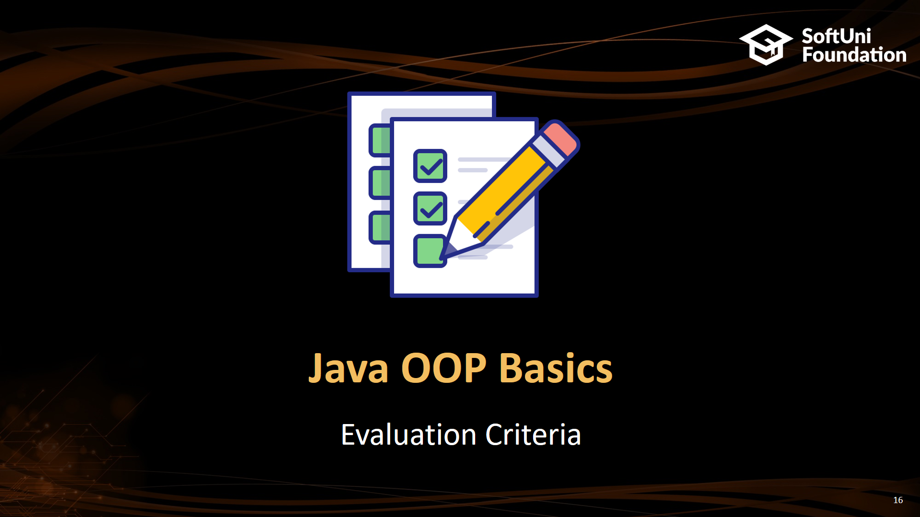
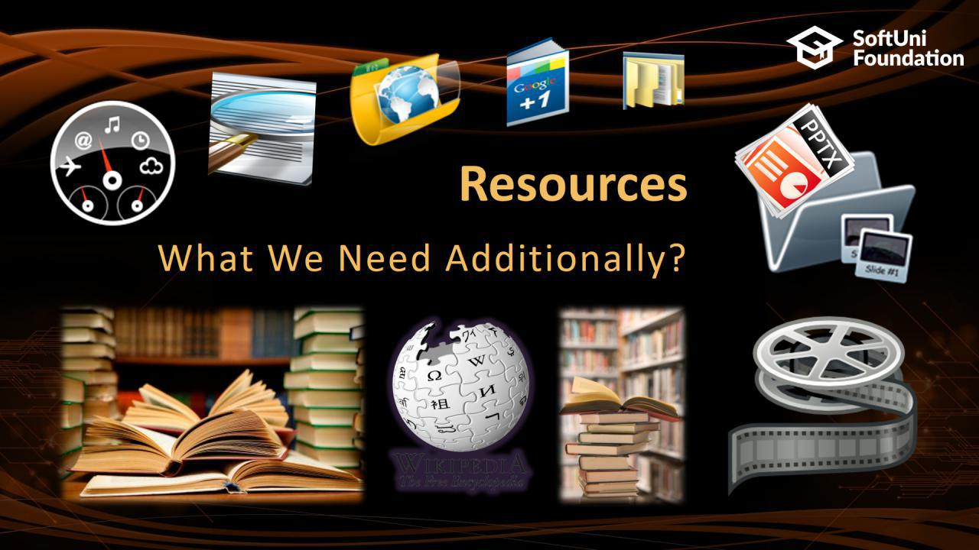
Table of Contents
<number>
Notes:
© Software University Foundation – http://softuni.org
This work is licensed under the Creative Commons Attribution-NonCommercial-ShareAlike license.
<number>

Slide 3






SoftUni Diamond Partners

Slide 4






SoftUni Diamond Partners

Slide 5
Questions
sli.do #java-fund
<number>

Slide 6

Java Fundamentals @ SoftUni
3 Months Java Fundamentals Training
Notes:
<number>
© Software University Foundation – http://softuni.org
This work is licensed under the Creative Commons Attribution-NonCommercial-ShareAlike license.

Slide 7
Java Fundamentals Module: Goals
„Java Fundamentals“ Module @ SoftUni
4 times weekly, lots of live coding and exercises
Part I – Java Advanced
Arrays, Matrices, Stacks and Queues, Sets and Maps, String, Functions and Lambda Expressions, Stream-API
Part II – Java OOP Basics
Defining Classes, Encapsulation, Inheritance, Polymorphism, Interfaces and Abstraction
Part III – Java OOP Advanced
Generics, Iterators and Comparators, Enums
<number>

Slide 8
Java Advanced Module at SoftUni – Timeline
14-May-2018
11-June-2018
9-July-2018
Java
Advanced
6 credits
4 weeks x 4 times / week
Final exam: 10-June-2018
Java OOP
Basics
9 credits
4 weeks x 4 times / week
Final exam: 8-July-2018
Java OOP
Advanced
12 credits
5 weeks x 4 times / week
Final exam: 12-August-2018
<number>

Slide 9

Java OOP Advanced
Course Objectives & Program
<number>

Slide 10
Java OOP Advanced – Course Program
Course Introduction – Course Program, Trainers, Exams, Resources
Generics– Generics, Covariance, Contravariance
Iterators and Comparators – Iterator, Iterable, Comparator, Comparable
Enums and Annotations –What is enumeration. What is Annotation. Writing Annotations.
Reflection – Reflection. Reflection API - Class.forName, .newInstance(), getDeclaredFields(), …
Unit Testing– What are unit tests? Unit testing framework (JUnit 4
<number>

Slide 11
Java OOP Advanced – Course Program(1)
Open/Closed, Liskov Substitution Principles– Aimed on extensible code
Interface Segregation, Dependency Inversion Principles– Aimed on loose coupling
Object Communication and Events– Middlewares, events - objects should know about minimum other objects
Open/Closed, Liskov Substitution Principles– Aimed on extensible code
Exam Preparation
Practical Exam
<number>

Slide 12

The Trainers Team
<number>

Slide 13
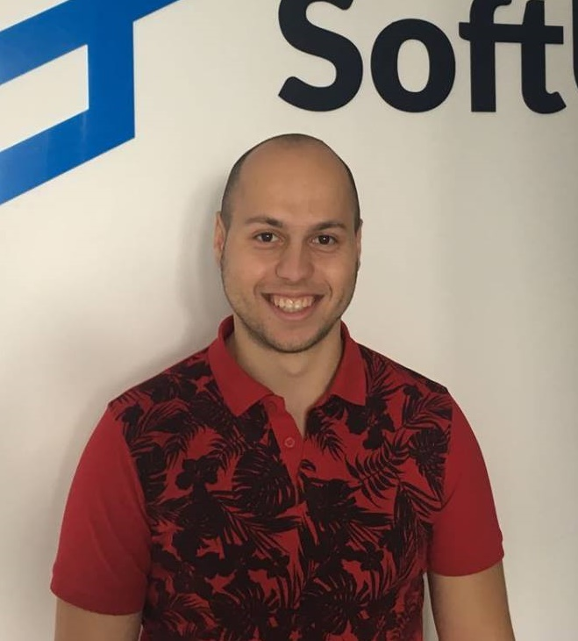
Ivo Hristov
Developer @ Musala Soft.
Experienced Technical Trainer
Passionate about Java Development
Top performing student @ SoftUni
<number>

Slide 14

Hristo Skipernov
Developer @ Glitch Ltd
Experienced Technical Trainer
Interested in Java and JavaScript
Top performing student @ SoftUni
<number>

Slide 15

Training Duration – Java Advanced
Lessons: ~30 hours (onsite + videos)
Practical exercises (in class): ~32 hours
Exam preparation: 3*4 hours
Exam: 6 hours
Schedule: July – August 2018
Exam date: 12 August 2018
<number>

Slide 16



Learn to Search in Internet
The course assignments require to search in Internet
This is an important part of the learning process
Some exercises intentionally have no hints
Learn to find solutions!
Software development includes everyday searching and learning
No excuses, just learn to study!
<number>

Slide 17

Java OOP Advanced
Evaluation Criteria
<number>

Slide 18


Scoring System for “Java OOP Basics”
Exam – 85%
Homework (exercises) – 15%
Bonuses: up to 10%
Presence in class: 5% (onsite students only)
<number>

Slide 19

Homework Assignments
Doing your homework is very important!
Programming can only be learned through a lot of practice!
You should write code every day!
Each lesson is followed by many exercises
Try to solve them in class
The rest are your homework
Homework assignments are due in 6 days after each lecture
Submission through our online judge system: judge.softuni.bgjudge.softuni.bg
<number>

Slide 20
Java Advanced Exam
Practical programming exam
1 practical problems for 6 hours
Code in Java
Automated judge system
http://judge.softuni.bg
Solutions are evaluated for correctness
<number>

Slide 21










Resources
What We Need Additionally?

Slide 22


Your RFID Chip
Students can either
Take RFID chip from SoftUni
Or use their own chip / card
Register your chip number in your SoftUni profile: https://softuni.bg/users/profile/show
Check-in at the reception every time when you come
See your last visits
<number>

Slide 23



JF Course Web Site, Forum and FB Group
Official web site:
Official discussion forum:
Official Facebook group
https://softuni.bg/trainings/1977/java-oop-advanced
https://softuni.bg/forum/categories/71/java-oop-advanced
fb.com/groups/SoftUniJavaFundamentalsMay2018/
<number>
Notes:
<number>

Slide 24
The Java Fundamentals Slides and Videos
All lecture slides, videos, homework assignments, projects and other resources are open content, available for free
Visit the course web site to access the course resources
<number>

Slide 25

Book “Introduction to Programming with Java”
Book Introprogramming
” Introduction to Programming with Java ”, Svetlin Nakov and Co., 2015, ISBN 9789544005276
in PDF, HTML, ePub, Kindle
Free download: introprogramming.info
<number>

Slide 26

Software University Learning System (SULS)
Software University Learning System (SULS)
www.softuni.bg
Important resource for students
Homework submissions
Homework check-up
Exams and results
Reports about your progress
<number>

Slide 27


Required Software
Software needed for this course:
IntelliJ IDEA 2018 Community (for Mac, Linux и Windows)
Alternative: Eclipse (for Mac, Linux и Windows)
<number>
Notes:
<number>

Slide 28

Summary
Training program
Generics, Iterators and Comparators,Enum and Annotations,Reflection,Unit Testing,Open/Closed,Liskov Substiton Principles, Interface Segregation, Dependency Inversion Principles, Object Communication and Events.
Practical exam
1 problems for 6 hours
Learning resources
<number>

Slide 29








Java Advanced – Course Overview
https://softuni.bg/courses/programming-fundamentals
Notes:
© Software University Foundation – http://softuni.org
This work is licensed under the Creative Commons Attribution-NonCommercial-ShareAlike license.
<number>

Slide 30
License
This course (slides, examples, demos, videos, homework, etc.) is licensed under the "Creative Commons Attribution-NonCommercial-ShareAlike 4.0 International" license
<number>
Notes:
© Software University Foundation – http://softuni.org
This work is licensed under the Creative Commons Attribution-NonCommercial-ShareAlike license.
<number>

Slide 31





Trainings @ Software University (SoftUni)
Software University – High-Quality Education, Profession and Job for Software Developers
softuni.bg
Software University Foundation
http://softuni.foundation/
Software University @ Facebook
facebook.com/SoftwareUniversity
Software University Forums
forum.softuni.bg
Notes:
© Software University Foundation – http://softuni.org
This work is licensed under the Creative Commons Attribution-NonCommercial-ShareAlike license.
<number>

